Slide 1


TanishqThakur
23 Jan 2023

Slide 2

Outline
Executive Summary
Introduction
Methodology
Results
Conclusion
Appendix

Slide 3
Executive Summary
• The following methodologies were used to analyze data:
Data Collection using web scraping and SpaceX API;
Exploratory Data Analysis (EDA), including data wrangling, data visualization and interactive visual analytics;
Machine Learning Prediction.
Summary of all results
It was possible to collected valuable data from public sources;
EDA allowed to identify which features are the best to predict success of launchings;
Machine Learning Prediction showed the best model to predict which characteristics are important to drive this opportunity by the best way, using all collected data.

Slide 4
Introduction
• The objective is to evaluate the viability of the new company Space Y to compete with Space X.
• Desirable answers:
• The best way to estimate the total cost for launches, by predicting successful landings of the first stage of rockets;
• Where is the best place to make launches

Slide 5

Section 1

Slide 6
Methodology
Executive Summary
Data collection methodology:
Data from Space X was obtained from 2 sources:
• Space X API - https://api.spacexdata.com/v4/rockets/
• WebScraping - https://en.wikipedia.org/wiki/List_of_Falcon/_9/_and_Falcon_Heavy_launches
Perform data wrangling
Collected data was enriched by creating a landing outcome label based on outcome data after summarizing and analyzing features
Perform exploratory data analysis (EDA) using visualization and SQL
Perform interactive visual analytics using Folium and Plotly Dash
Perform predictive analysis using classification models
How to build, tune, evaluate classification models

Slide 7
Data Collection
Data sets were collected from Space X API using requests (https://api.spacexdata.com/v4/rockets/) and from Wikipedia (https://en.wikipedia.org/wiki/List_of_Falcon/_9/_and_Falcon_Heavy_launches), using web scraping technics

Slide 8
Data Collection – SpaceX API
• SpaceX offers a public API from where data can be obtained and then used;
• This API was used according to the flowchart beside and then data is persisted.
Source Code: Data Collection - SpaceX API
Use requests to call SPACEX API
Parse it from JSON to Pandas Dataframe
Remove all values that are not FALCON 9
Clean the data by removing missing values

Slide 9
Data Collection - Scraping
• Data from SpaceX launches can also be obtained from Wikipedia;
• Data are downloaded from Wikipedia according to the flowchart and then persisted.
Source Code: Data Collection - Scraping
Request the Falcon 9 Launch Wiki Page
Extract all column/variable names from HTML Table Header
Create data frame by parsing the launch HTML Tables

Slide 10
Data Wrangling
• Initially some Exploratory Data Analysis (EDA) was performed on the dataset.
• Then the summaries launches per site, occurrences of each orbit and occurrences of mission outcome per orbit type were calculated.
• Finally, the landing outcome label was created from Outcome column.
Source Code: Data Wrangling
EDA
Summarizations
Creation of landing outcome labels

Slide 11
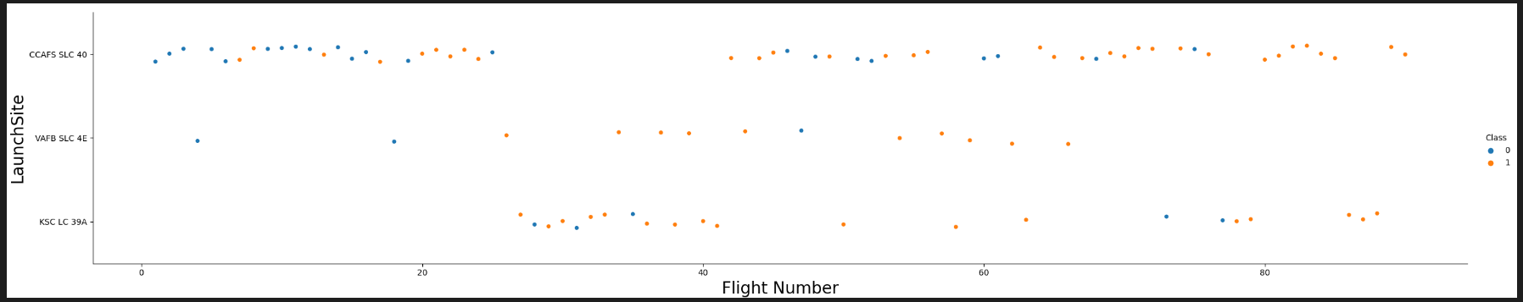
EDA with Data Visualization
To explore data, scatterplots and barplots were used to visualize the relationship between pair of features:
Payload Mass X Flight Number, Launch Site X Flight Number, Launch Site X Payload Mass, Orbit and Flight Number, Payload and Orbit
Source code: EDA with Data Visualization

Slide 12
EDA with SQL
Names of the unique launch sites in the space mission;
• Top 5 launch sites whose name begin with the string 'CCA’;
• Total payload mass carried by boosters launched by NASA (CRS);
• Average payload mass carried by booster version F9 v1.1;
• Date when the first successful landing outcome in ground pad was achieved;
• Names of the boosters which have success in drone ship and have payload mass between 4000 and 6000 kg;
• Total number of successful and failure mission outcomes;
• Names of the booster versions which have carried the maximum payload mass;
• Failed landing outcomes in drone ship, their booster versions, and launch site names for in year 2015; and
• Rank of the count of landing outcomes (such as Failure (drone ship) or Success (ground pad)) between the date 2010-06-04 and 2017-03-20.
Source code: EDA with SQL

Slide 13
Build an Interactive Map with Folium
• Markers, circles, lines and marker clusters were used with Folium Maps
• Markers indicate points like launch sites;
• Circles indicate highlighted areas around specific coordinates, like NASA Johnson Space Center;
• Marker clusters indicates groups of events in each coordinate, like launches in a launch site; and
• Lines are used to indicate distances between two coordinates.
Source code : Folium Maps

Slide 14
Build a Dashboard with Plotly Dash
• The following graphs and plots were used to visualize data
• Percentage of launches by site
• Payload range
• This combination allowed to quickly analyze the relation between payloads and launch sites, helping to identify where is best place to launch according to payloads.

Slide 15
Predictive Analysis (Classification)
Data Preparation and standardization
Test of each model with combinations of hyperparameters
Comparison of results
Four classification models were compared: logistic regression, support vector machine, decision tree and k nearest neighbors.
Source code: Predictive analysis

Slide 16
Results
• Exploratory data analysis results:
• Space X uses 4 different launch sites;
• The first launches were done to Space X itself and NASA;
• The average payload of F9 v1.1 booster is 2,928 kg;
• The first success landing outcome happened in 2015 fiver year after the first launch;
• Many Falcon 9 booster versions were successful at landing in drone ships having payload above the average;
• Almost 100% of mission outcomes were successful;
• Two booster versions failed at landing in drone ships in 2015: F9 v1.1 B1012 and F9 v1.1 B1015;
• The number of landing outcomes became as better as years passed.

Slide 17
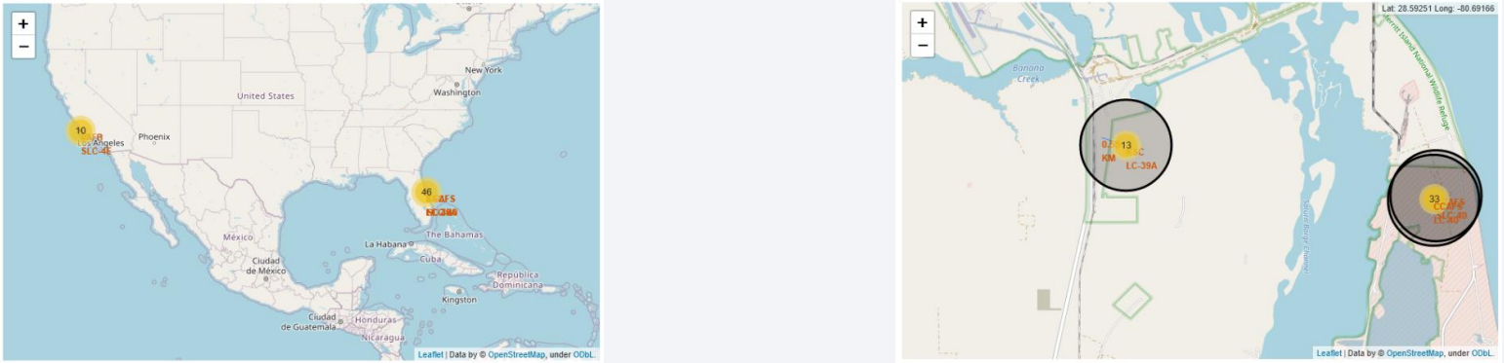
Results
• Using interactive analytics was possible to identify that launch sites use to be in safety places, near sea, for example and have a good logistic infrastructure around.
• Most launches happens at east cost launch sites.

Slide 18
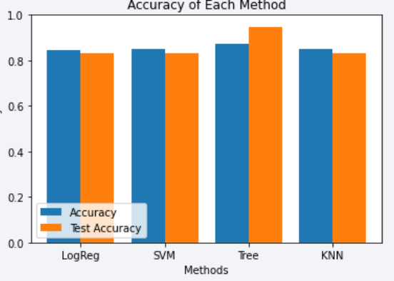
Results
• Predictive Analysis showed that Decision Tree Classifier is the best model to predict successful landings, having accuracy over 87% and accuracy for test data over 94%.

Slide 19

Section 2

Slide 20
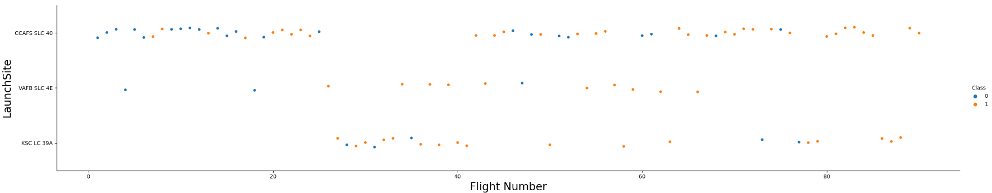
Flight Number vs. Launch Site
• According to the plot above, it’s possible to verify that the best launch site nowadays is CCAF5 SLC 40, where most of recent launches were successful;
• In second place VAFB SLC 4E and third place KSC LC 39A;
• It’s also possible to see that the general success rate improved over time.

Slide 21
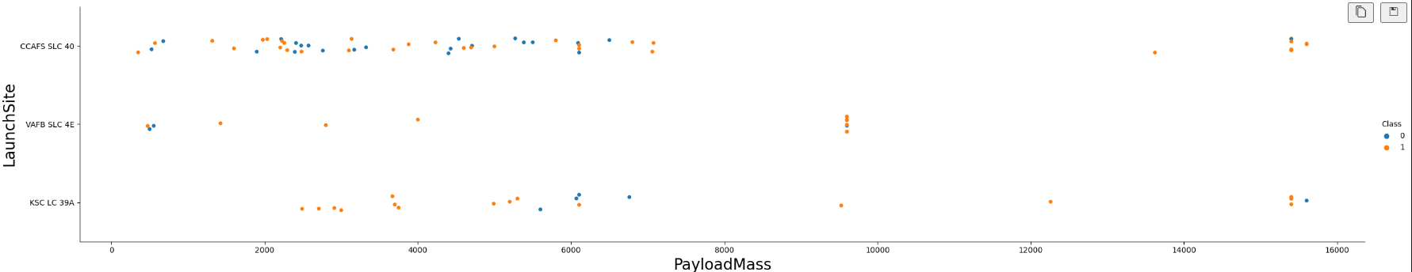
Payload vs. Launch Site
• Payloads over 9,000kg (about the weight of a school bus) have excellent success rate;
• Payloads over 12,000kg seems to be possible only on CCAFS SLC 40 and KSC LC 39A launch sites.

Slide 22
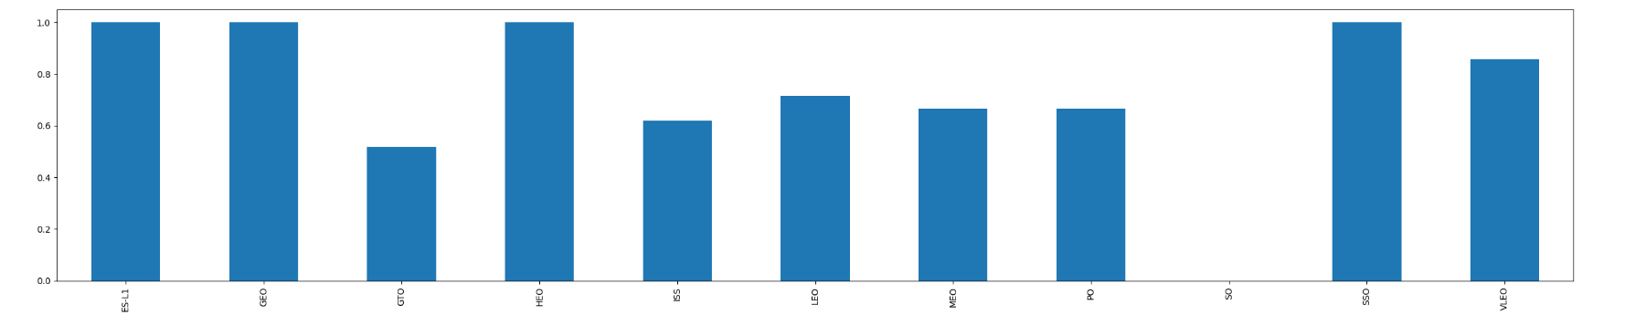
Success Rate vs. Orbit Type
The biggest success rates happens to orbits:
ES-L1;
GEO;
HEO; and
SSO.
Followed by:
VLEO (above 80%); and
LFO (above 70%).

Slide 23
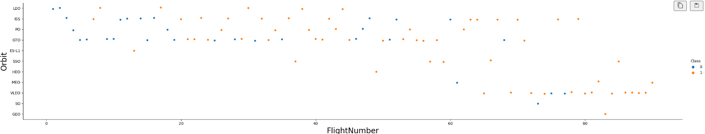
Flight Number vs. Orbit Type
• Apparently, success rate improved over time to all orbits;
• VLEO orbit seems a new business opportunity, due to recent increase of its frequency.

Slide 24
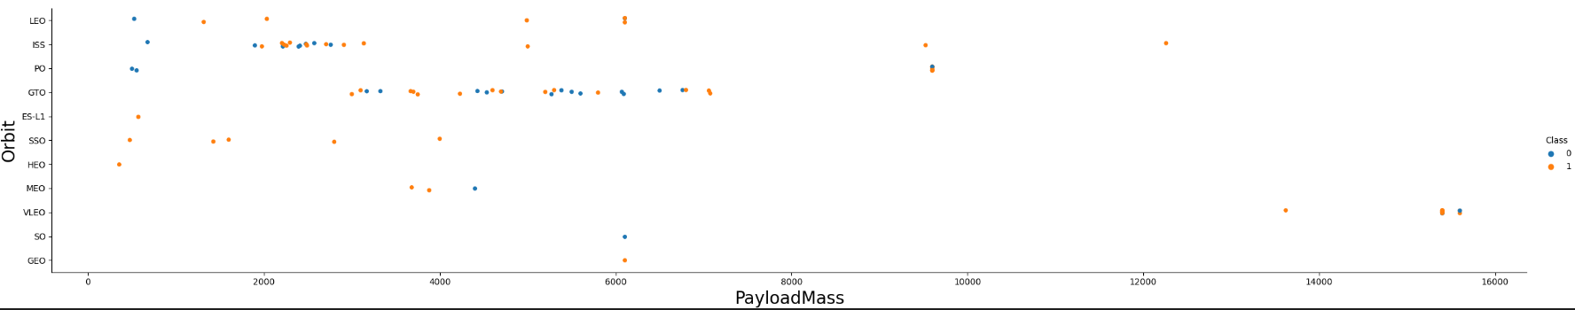
Payload vs. Orbit Type
• Apparently, there is no relation between payload and success rate to orbit GTO;
• ISS orbit has the widest range of payload and a good rate of success;
• There are few launches to the orbits SO and GEO.

Slide 25
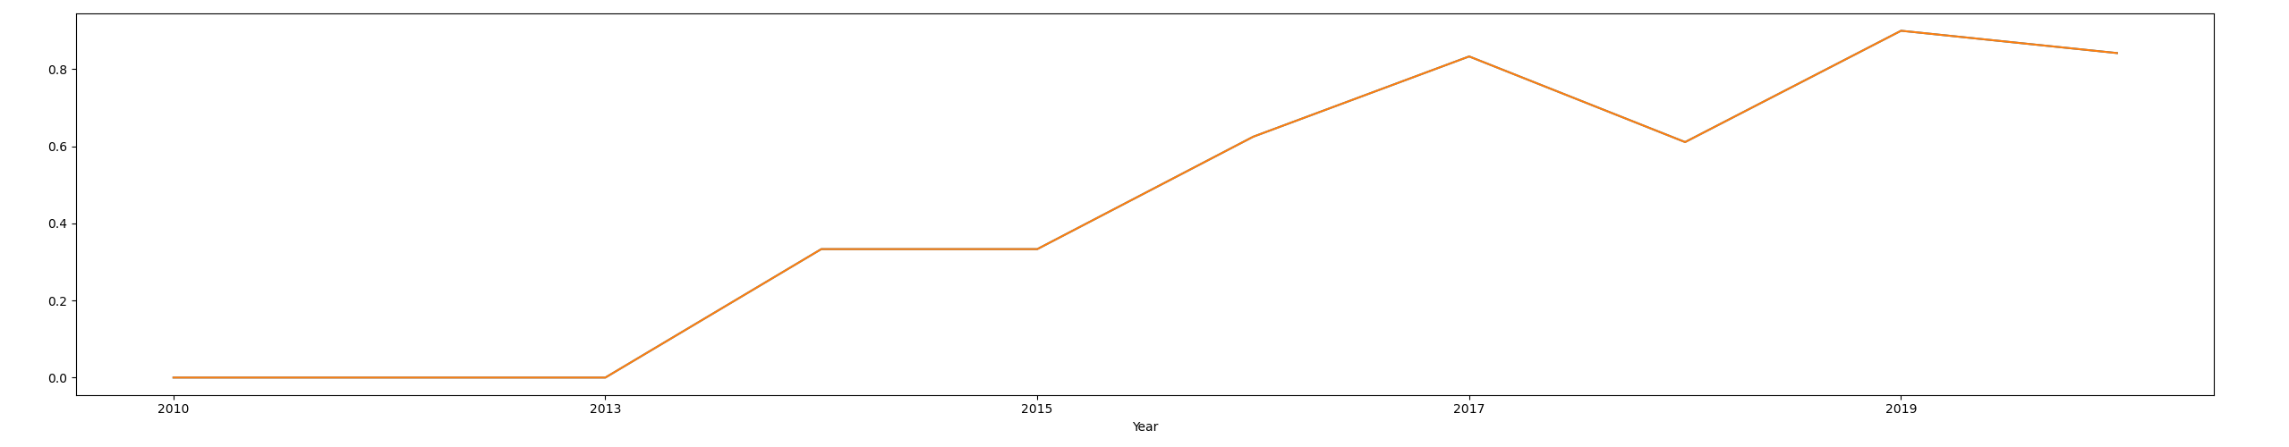
Launch Success Yearly Trend
• Success rate started increasing in 2013 and kept until 2020;
• It seems that the first three years were a period of adjusts and improvement of technology.

Slide 26
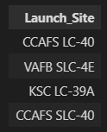
All Launch Site Names
• According to data, there are four launch sites
• They are obtained by selecting unique occurrences of “launch_site” values from the dataset.

Slide 27
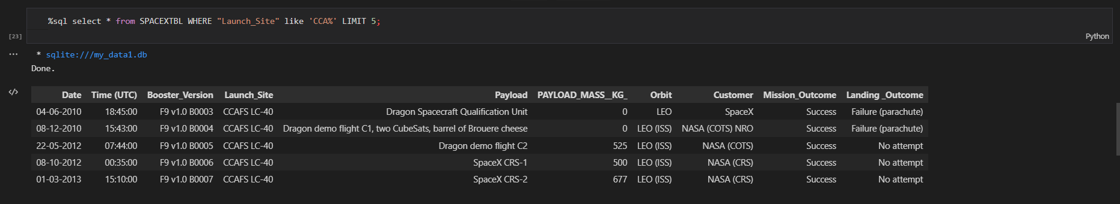
Launch Site Names Begin with 'CCA'
• Here we can see five samples of Cape Canaveral launches.

Slide 28
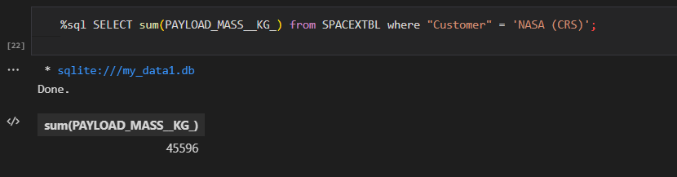
Total Payload Mass
• Total payload carried by boosters from NASA:
• Total payload calculated above, by summing all payloads whose Customer is NASA (CRS), which corresponds to NASA.

Slide 29
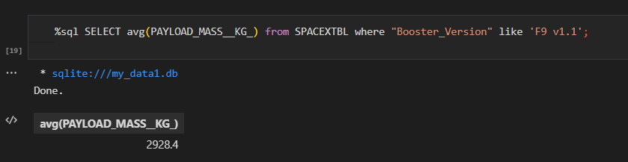
Average Payload Mass by F9 v1.1
• Average payload mass carried by booster version F9 v1.1:
• Filtering data by the booster version above and calculating the average payload mass we obtained the value of 2,928 kg.

Slide 30
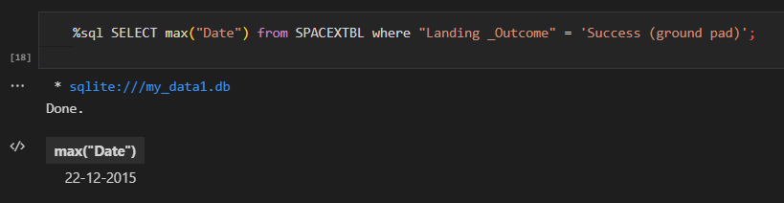
First Successful Ground Landing Date
• First successful landing outcome on ground pad:
• By filtering data by successful landing outcome on ground pad and getting the minimum value for date it’s possible to identify the first occurrence, that happened on 22/12/2015.

Slide 31
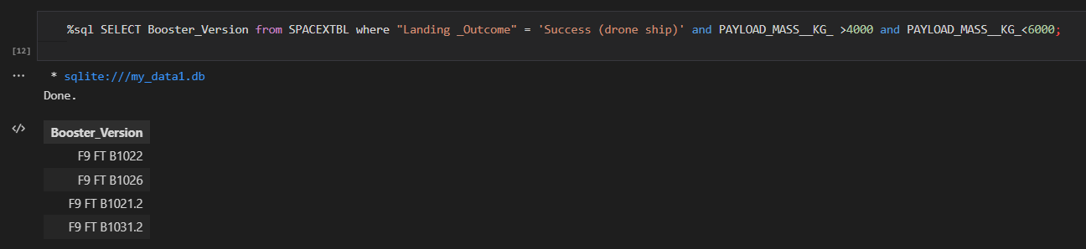
Successful Drone Ship Landing with Payload between 4000 and 6000
• Boosters which have successfully landed on drone ship and had payload mass greater than 4000 but less than 6000
• Selecting distinct booster versions according to the filters above, these 4 are the result.

Slide 32
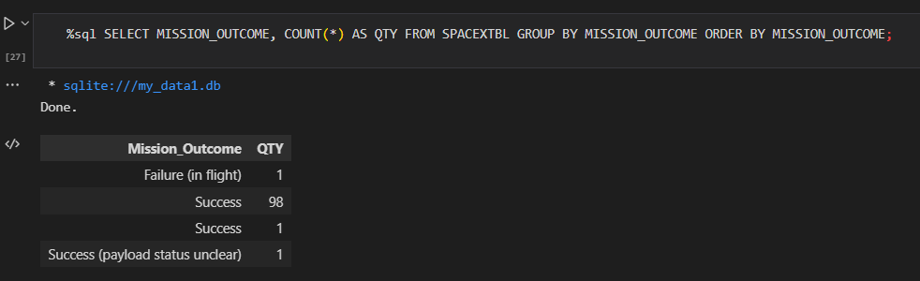
Total Number of Successful and Failure Mission Outcomes
• Number of successful and failure mission outcomes:
• Grouping mission outcomes and counting records for each group led us to the summary above.

Slide 33
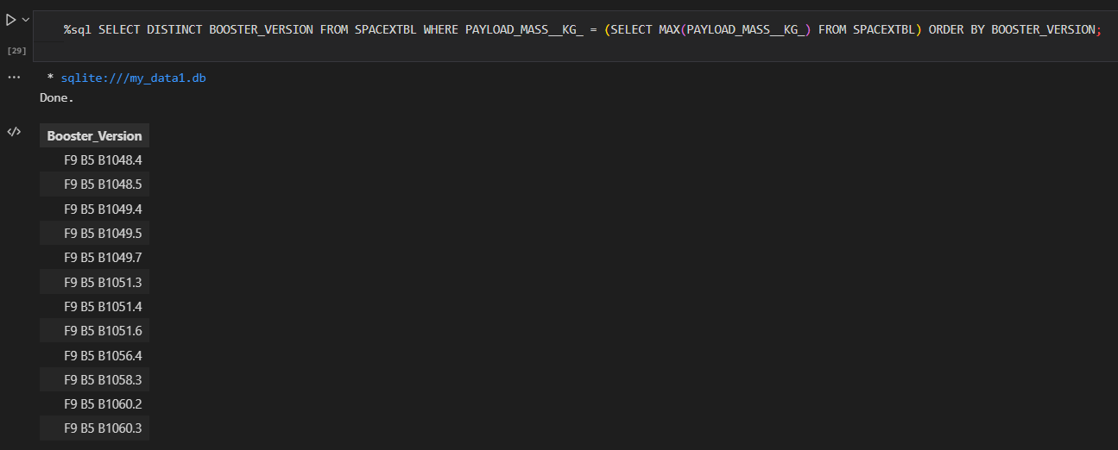
Boosters Carried Maximum Payload
• Boosters which have carried the maximum payload mass
• These are the boosters which have carried the maximum payload mass registered in the dataset.

Slide 34
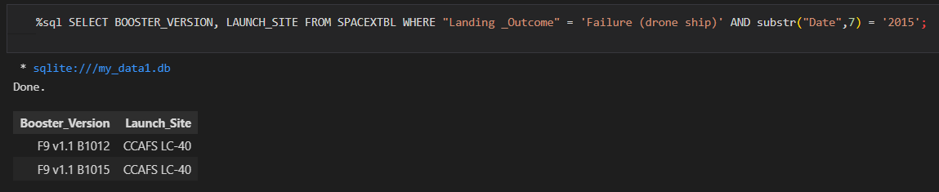
2015 Launch Records
• Failed landing outcomes in drone ship, their booster versions, and launch site names for in year 2015
• The list above has the only two occurrences.

Slide 35
Rank Landing Outcomes Between 2010-06-04 and 2017-03-20
• Ranking of all landing outcomes between the date 2010-06-04 and 2017- 03-20:
• This view of data alerts us that “No attempt” must be taken in account.

Slide 36

Section 3

Slide 37
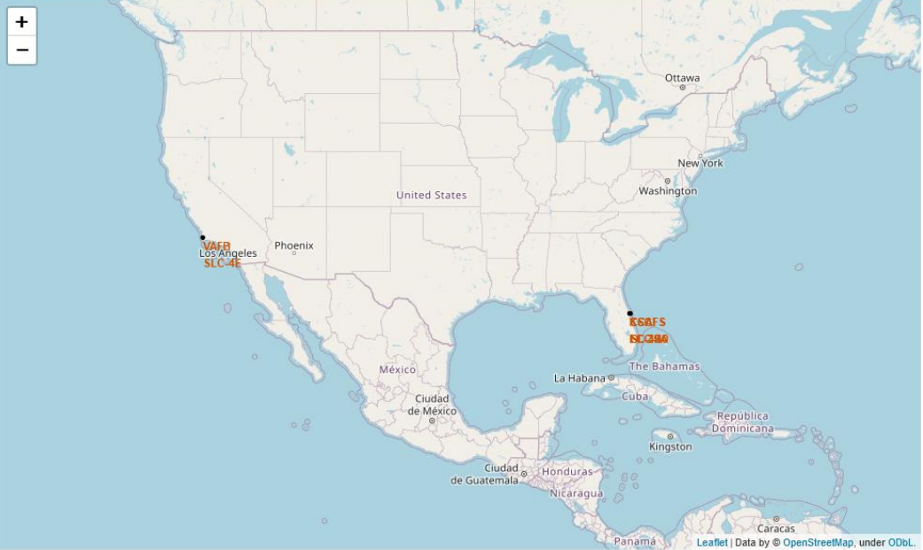
All launch sites
• Launch sites are near sea, probably by safety, but not too far from roads and railroads.

Slide 38
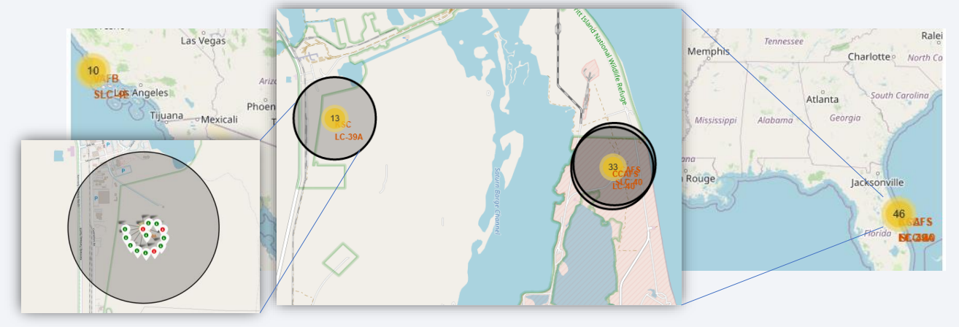
Launch Outcomes by Site
• Example of KSC LC-39A launch site launch outcomes
• Green markers indicate success and red ones indicate failure.

Slide 39
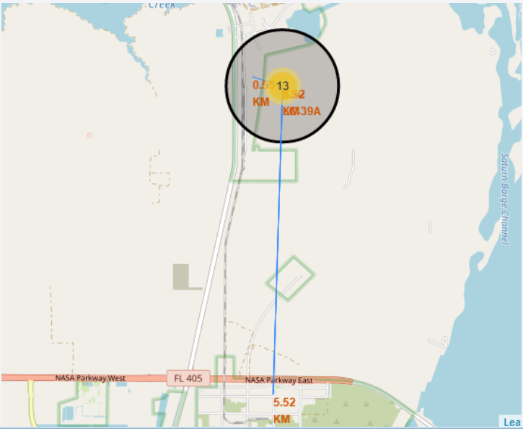
Logistics and Safety
• Launch site KSC LC-39A has good logistics aspects, being near railroad and road and relatively far from inhabited areas.

Slide 40

Section 4

Slide 41
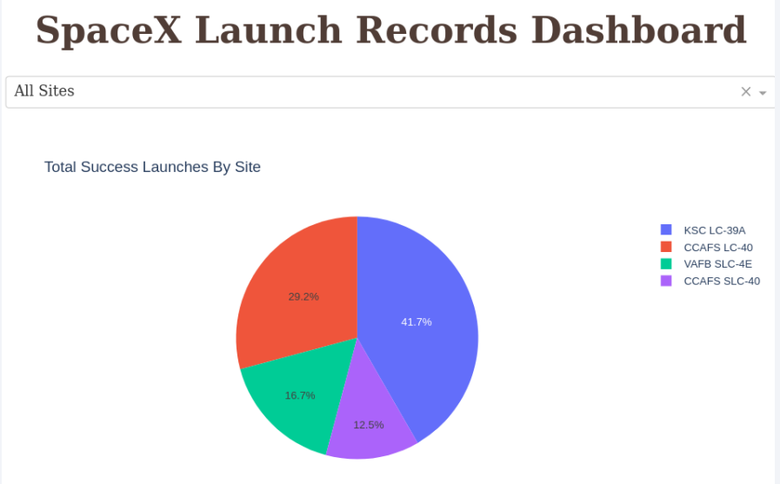
Successful Launches by Site
The place from where launches are done seems to be a very important factor of success of missions.

Slide 42
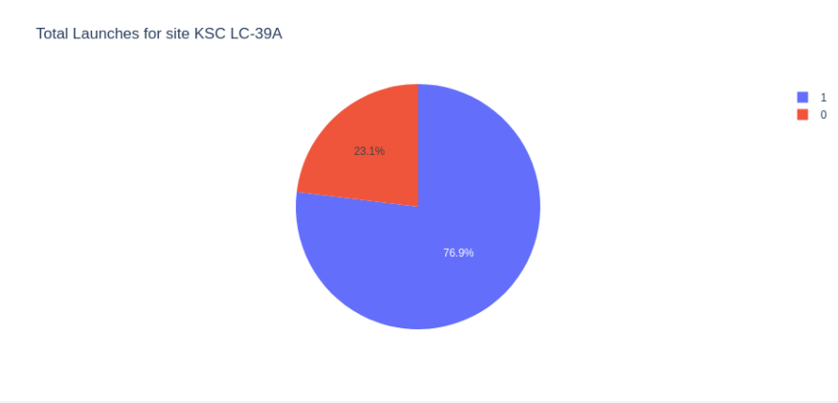
Launch Success Ratio for KSC LC-39A
76.9% of launches are successful in this site.

Slide 43
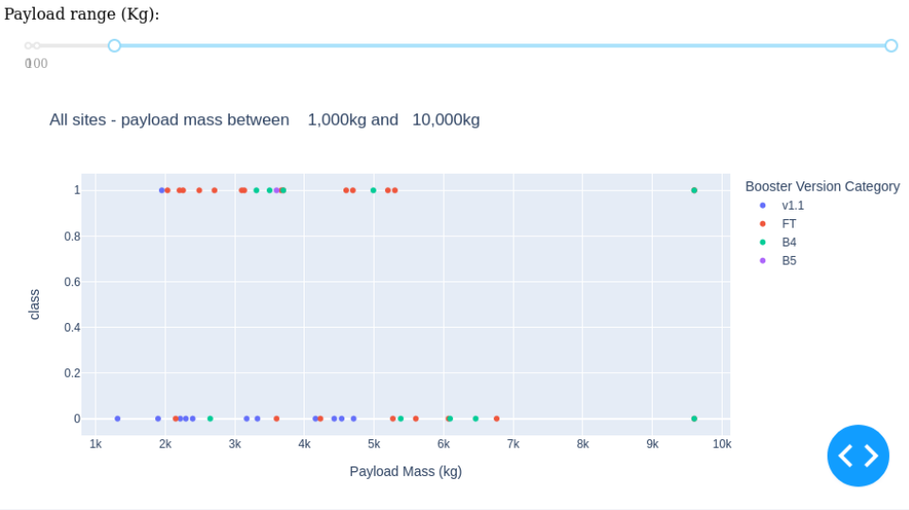
Payload vs. Launch Outcome
• Payloads under 6,000kg and FT boosters are the most successful combination.

Slide 44
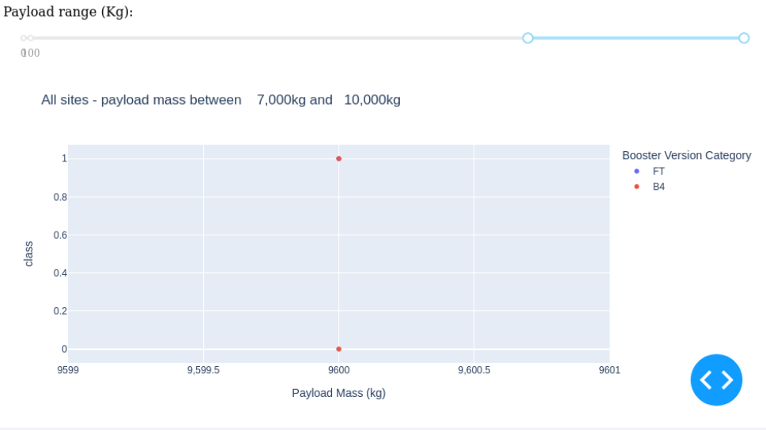
Payload vs. Launch Outcome
• There’s not enough data to estimate risk of launches over 7,000kg

Slide 45

Section 5

Slide 46
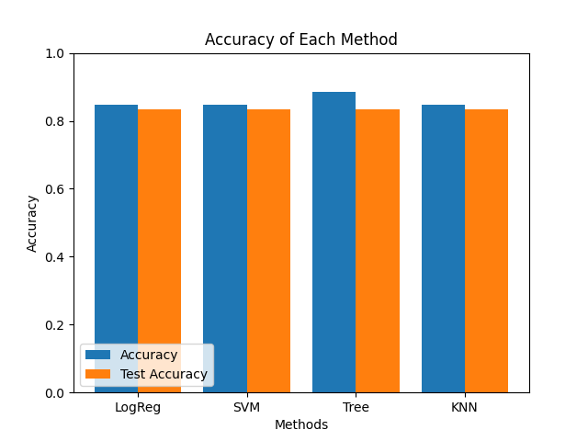
Classification Accuracy
• Four classification models were tested, and their accuracies are plotted beside;
• The model with the highest classification accuracy is Decision Tree Classifier, which has accuracies over than 87%.

Slide 47
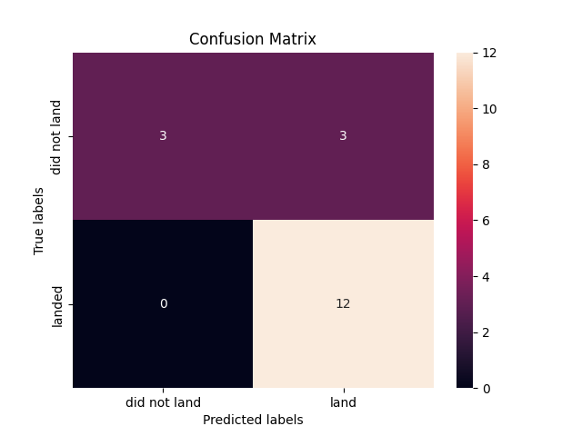
Confusion Matrix
• Confusion matrix of Decision Tree Classifier proves its accuracy by showing the big numbers of true positive and true negative compared to the false ones.

Slide 48
Conclusions
• Different data sources were analyzed, refining conclusions along the process;
• The best launch site is KSC LC-39A;
• Launches above 7,000kg are less risky;
• Although most of mission outcomes are successful, successful landing outcomes seem to improve over time, according the evolution of processes and rockets;
• Decision Tree Classifier can be used to predict successful landings and increase profits.

Slide 49
Appendix
Include any relevant assets like Python code snippets, SQL queries, charts, Notebook outputs, or data sets that you may have created during this project

Slide 50


